Slide 1


SEICHE 2022 Basic Arduino Programming
Instructor: Paul Frommeyer
www.paulfrommeyer.com
Corporate Sponsor: DXC Technology

Slide 2
YOUR INSTRUCTOR
Career
Computer Infrastructure Engineer (30+ yrs)
Apple Computer – Sony – General Magic
Cisco Systems – HP/HPE/DXC [current]
Linux/Unix Sysadmin (20+ years)
C developer (professionally just entry level)
BS Computer Science, BS Philosophy
Personal
Ubergeek-at-large
Computers, electronics, woodworking - Electronics since 6th grade - Computers since 7th grade

Slide 3
“Lesson” 1 – Intro and Setup
Part A
Introduction to class format
Overview of lesson plan
Presentation format (monitor, camera, screen, whiteboard)
Inventory of USB Drives
Part B
Installation of device drivers (Windows)
Installation of Arduino IDE

Slide 4
Class Format and Goals “Detailed understanding of basic C language programming”
Goals
IDE software installation
Installing and configuring new boards
Installing and using software libraries
Loading software onto a board
Accessing and using example programs
Understand how computers represent numbers and letters
Arduino C++ programming basics
Using an LED matrix display
To Be Avoided
Detailed electronics knowledge and physical wiring of components
Processor internals and microcontroller internal architecture
Extensive math, computer science, or EE

Slide 5
The Maker and Hacker Approach
The maker culture is a contemporary subculture representing a technology-based extension of DIY culture that intersects with hardware-oriented parts of hacker culture and revels in the creation of new devices as well as tinkering with existing ones. The maker culture in general supports open-source hardware. Typical interests enjoyed by the maker culture include engineering-oriented pursuits such as electronics, robotics, 3-D printing, and the use of computer numeric control tools, as well as more traditional activities such as metalworking, woodworking, and, mainly, its predecessor, traditional arts and crafts.
The subculture stresses a cut-and-paste approach to standardized hobbyist technologies, and encourages cookbook re-use of designs published on websites and maker-oriented publications.[1][2] There is a strong focus on using and learning practical skills and applying them to reference designs.
– Wikipedia
The hacker culture is a subculture of individuals who enjoy the intellectual challenge of creatively overcoming the limitations of software systems to achieve novel and clever outcomes.[1] The act of engaging in activities (such as programming or other media[2]) in a spirit of playfulness and exploration is termed hacking. However, the defining characteristic of a hacker is not the activities performed themselves (e.g. programming), but how it is done[3] and whether it is exciting and meaningful.[2]
…
Richard Stallman explains about hackers who program:
What they had in common was mainly love of excellence and programming. They wanted to make their programs that they used be as good as they could. They also wanted to make them do neat things. They wanted to be able to do something in a more exciting way than anyone believed possible and show "Look how wonderful this is. I bet you didn't believe this could be done."[7]
Hackers from this subculture tend to emphatically differentiate themselves from what they pejoratively call "crackers"; those who are generally referred to by media and members of the general public using the term "hacker", and whose primary focus‍—‌be it to malign or for malevolent purposes‍—‌lies in exploiting weaknesses in computer security.[8]
– Wikipedia

Slide 6
Lesson Plan Overview
Lesson 1 – Intro and Setup [may require 2 classes]
Introduction to class format
Overview of lesson plan
Presentation format (monitor, camera, screen, whiteboard)
Review of microcontrollers and types of boards
SEICHE LED display architecture
ESP8266 pinout
High level architecture
Lesson 2 – Laptop operation review – Windows and Linux
Inventory of USB drives
Installation of Arduino IDE software
Installation of CH340/ESP8266 serial port drivers (Windows only)
Control panel/settings location
Home directories and folder hierarchy
Arduino file locations
Search functions
(Windows) Device Manager
(Linux) Konsole
Copying flash drive contents [critical]
Open questions and issues
Lesson 3 – IDE essentials
Starting the Arduino IDE
Basic Arduino sketch (program) structure
Loading example sketches
Loading and configuring new boards
Connecting boards
Identifying the microcontroller serial port
Linux
Windows
Libraries
Uploading a sketch
The serial port monitor
Printing to the serial port monitor
A note on brace formatting
Lesson 4/5 – The Binary Number System (may take 2-3 lessons)
Numerals vs numbers
Review: the base 10 system and digit place values
New: the base 2 system and digit place values
Counting to 1000
Bits and bytes and nybbles
Binary addition and subtraction
Formatting printed output
Shifting and exponents
Lesson 6/7 – Integers and Arithmetic Operators (may take 2 lessons)
The integer data type
Variables and the assignment operator
Autoincrement and autodecrement
Arithmetic Operators
Assigning arithmetic results to a variable
Bytes as data types
Lesson 8 – Communicating with Sensors
Reading a potentiometer
Reading a button
Initializing I2C sensors
Reading I2C sensors
Lesson 9 – Characters and Arrays
The hexadecimal number system
Representing characters as numbers
The ASCII character code
The char data type
Strings and character arrays
Lesson 10 – Comparison Operators
==, =>, <=
strcmp
Binary comparisons
Uploading a sketch to the microcontroller
Lesson 11 – Control Structures
if-then-else
while
for-next
Lesson 12 – Programming the LED matrix
Initializing the SPI interface
Controlling display brightness
Lighting and clearing a single pixel
Displaying text on the LED matrix
Default fonts
Nested for-next loops

Slide 7
USB Flash Drive Inventory
DOCUMENTATION – Arduino Reference
Programming with Arduino.pdf
Arduino Cookbook-2ndEdition.pdf
Arduino-For-Beginners-REV2.pdf
IntroArduinoBook-AlanSmith.pdf
IntroductionToArduino-Book-AlanGSmith.pdf
Make_Getting_Started_with_Arduino_3E.pdf
DOCUMENTATION – Electronics Reference
the-original-guide-to-boards-2021.pdf
Basic Electronics-Semiconductors.pdf
Grobs Basic Electronics 2010.pdf
Instructables-Basic-Electronics.pdf
Intro to Electronics-Noisemantra.pdf
Make Electronics 2nd Edition by Charles Platt.pdf
SPIE-TT107-PracticalElectronicsforOpticalDesignandEngineering-Chapter1.pdf
DOCUMENTATION – ESP8266
ESP8266 pinout diagram
DOCUMENTATION – Boards Guides
Original Boards Guides from 2019-2022
DOCUMENTATION – Class Information
SEICHE-BasicArduinoProgramming-Lesson1-V1.pdf
Critical Documents
Make Getting Started With Arduino – Use this for self study and back reference
Arduino Cookbook 2nd Edition – Use this for reference and advanced study
Make Electronics 2nd Edition – Use this for self study and back reference
RETURN FLASH DRIVES AT END OF EACH LESSON
I’ll load new content each week, at least that week’s lesson but also sketches

Slide 8
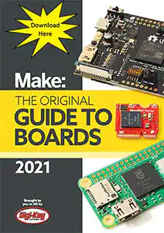
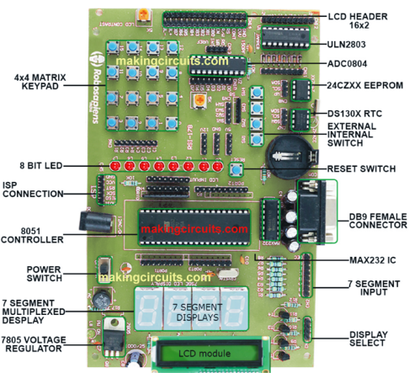
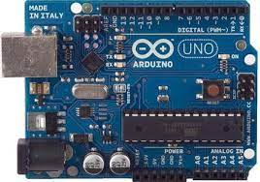
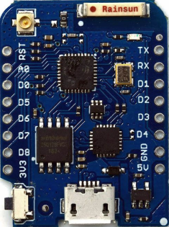
Microcontroller Evolution
Originally were microprocessors with separate memory, I/O
As chip transistor density increased, it become possible to integrate all components onto a single System on a Chip, or SoC
SoCs evolved from embedded systems to user/hobbyist-accessible
An SoC microcontroller made in a user-accessible format is called a microcontroller board or just “board” for short
All boards offer General Purpose I/O (GPIO) pins which do a variety of things
First and most famous user accessible microcontroller is the Arduino Uno
We now have hundreds of microcontroller boards to choose from
See https://makingcircuits.com/blog/types-of-microcontroller-boards-and-their-applications/ for details and examples
Arduino Uno
LOLIN WeMos D1 Mini
A vintage embedded microcontroller
The Make/Digi-Key Boards Guide

Slide 9
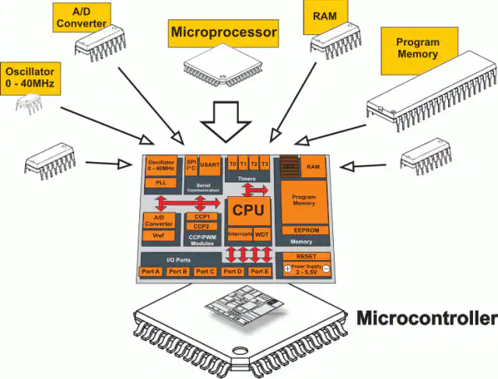
Generic Microcontroller Architecture
All microcontrollers use a similar architecture with similar parts. There are unique features for each processor and each board, yet they all have basic concepts in common
Central Processing Unit (CPU)
Running program memory (Dynamic RAM)
Stored program memory (Flash)
I/O ports and signal converters
Clock source and timers
Power regulator

Slide 10
Microcontroller Differences
In addition to unique features to numerous to cover, there are some things that will be different between microprocessors. These are cost/benefit tradeoffs.
Size of dynamic program memory (DRAM)
Size of offline program storage (Flash memory)
Speed of the processor (base clock speed, e.g., 120Mhz)
Addressing and data sizes the processor can handle, e.g., 8-bit vs 32-bit
Number of General Purpose I/O connections
Number and resolution of analog ports (ADC)
Number and type of serial connections available
Number of ports capable of pulse width modulation (PWM) output
How the microcontroller is flashed with new software
Integrated WiFi and/or Bluetooth
Integrated USB connectivity (some boards don’t have this!)
More subtle differences
The number and type of internal timers available
Which ports can act as interrupt inputs
How the internal port configuration registers work

Slide 11
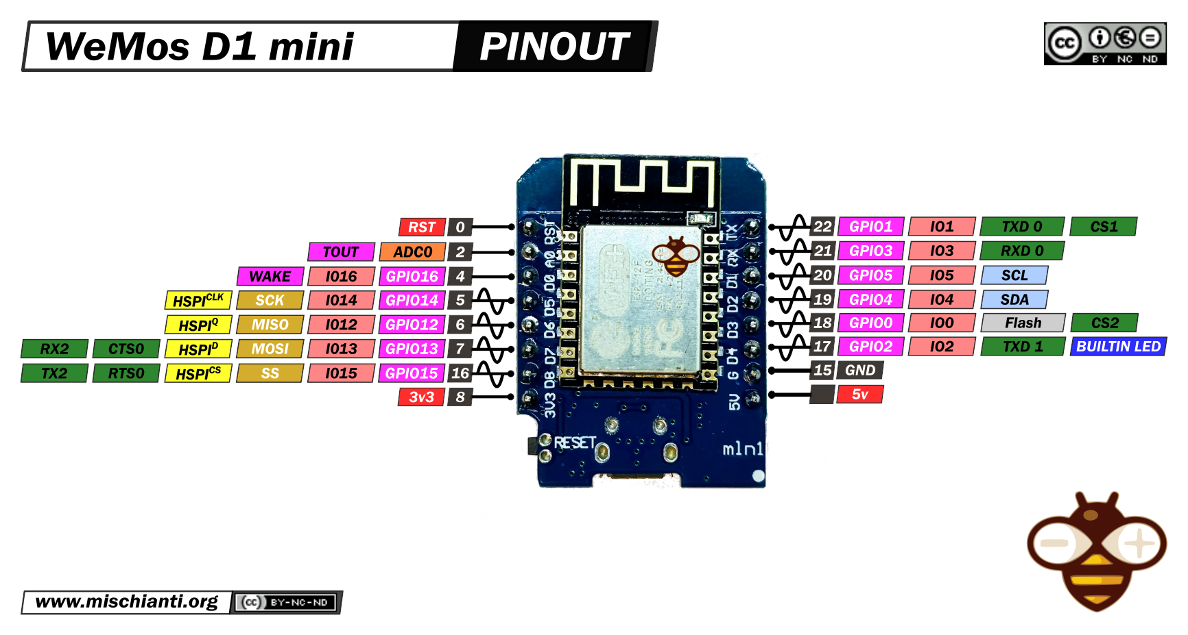
Our Microcontroller: The WeMos D1 Mini
Hilights
11 digital IO: all are interrupt and pwm capable (except D0/GPIO16)
1 analog input (3.2V max input): A0/ADC0
Micro USB or Type-C USB Port (clones usually have micro USB)
Two SPI interfaces (one is used for on-board flash memory), one I2C interface, two serial ports
Built-in WiFi (client or standalone access point modes) and Bluetooth
Compatible with MicroPython, Arduino, NodeMCU
Uses the CH340 USB-to-serial driver (installation usually needed on Windows)
Extremely low cost (approx $3.00 US on Amazon; one of the two least expensive components in your kits)

Slide 12
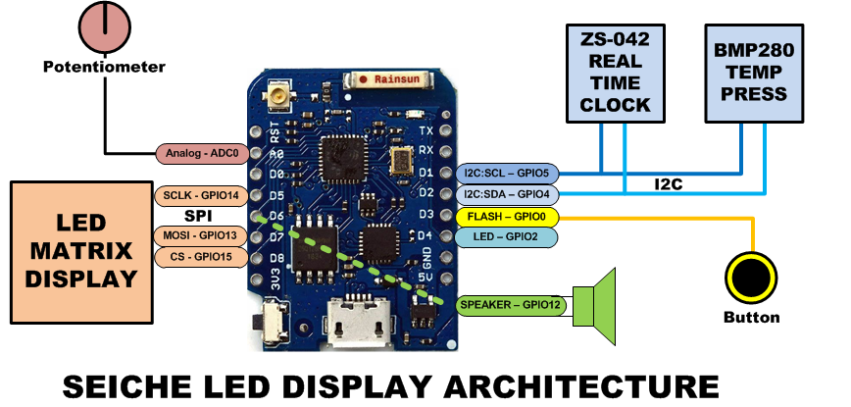
SEICHE LED Display Architecture
Red MAX7219 8x32 LED matrix display (SPI)
ZS-042 real-time clock module (I2C)
BMP280 Temperature and Pressure Sensor (I2C)
Piezoelectric speaker (PWM)
10KΩ Potentiometer (Analog-to-Digital Converter)
Button (Pullup and interrupt)

Slide 13
Formal End of Lesson 1
HOMEWORK!
Getting Started With Arduino – Chapter 3
Arduino Cookbook – Chapter 1
In next week’s exciting episode
USB drive distribution and contents
Installing CH340 drivers
Installing the Arduino IDE

